Slide 1

Crypto + QRock
YoungH

Slide 2
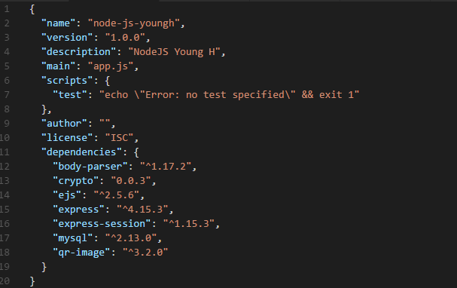
Package JSON
body-parser
crypto
ejs
express
express-session
mysql
qr-image

Slide 3
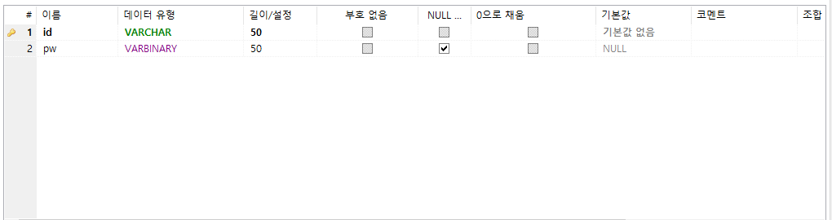
Database Table
Member

Slide 4
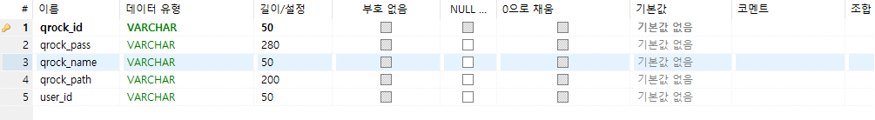
Database Table
Qrock

Slide 5
User Logic
User Sign up and Sign in
User insert door lock serial number
Door lock directory was created
Door lock directory saved image

Slide 6
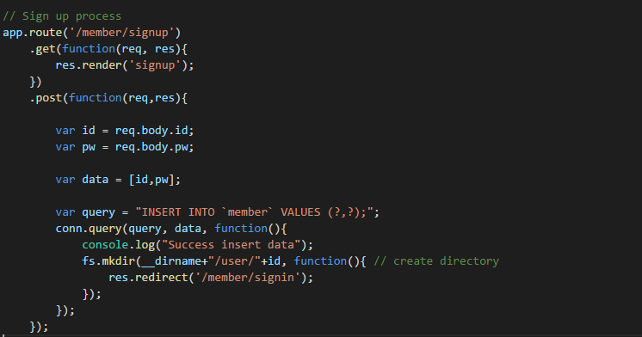
System Logic
* User Sign up

Slide 7
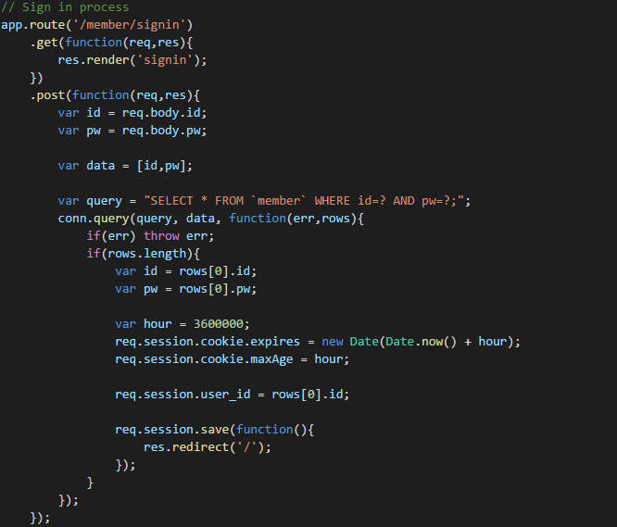
System Logic
* User Sign in

Slide 8
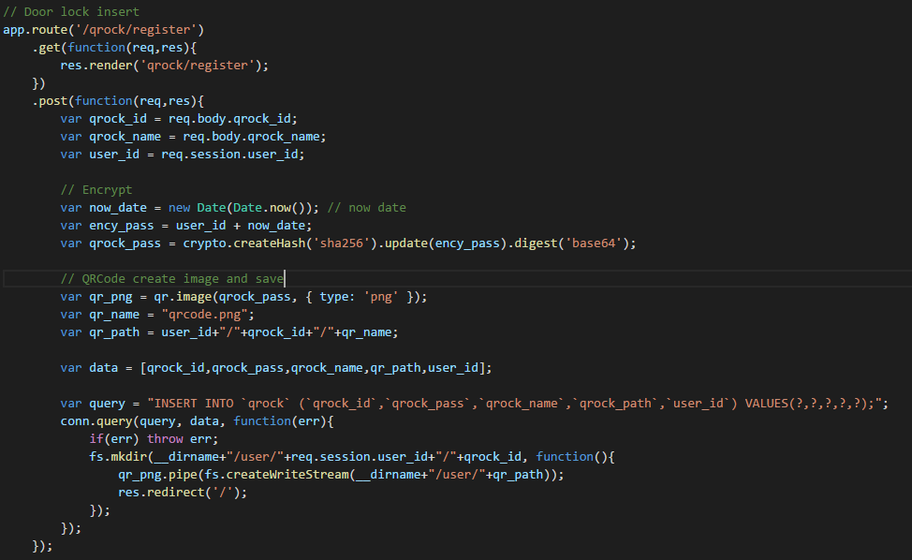
System Logic
* Door lock insert

Slide 9
System Logic
* Door lock insert

Slide 10
Thank you for watching
2017-06-05

